Slide 1
Road Intersections

Slide 2
Intersection
Two or more streets join or cross at-grade.
The intersection includes the areas needed for all modes of travel: pedestrian, bicycle, motor vehicle, and transit.
Intersections are a key feature of street design in four respects:
Focus of activity - The land near intersections often contains a concentration of travel destinations.
Conflicting movements - Pedestrian crossings, vehicle and bicycle turning and crossing movements are typically concentrated at intersections.
Traffic control - At intersections, movement of users is assigned by traffic control devices such as yield signs, stop signs, and traffic signals. For this intersections are often major cause of delay, but helps to organize traffic and reduce the potential for conflicts.
Capacity - In many cases, traffic control at intersections limits the capacity of the intersecting roadways which is defined as the number of vehicles that can be accommodated within a given period of time.

Slide 3
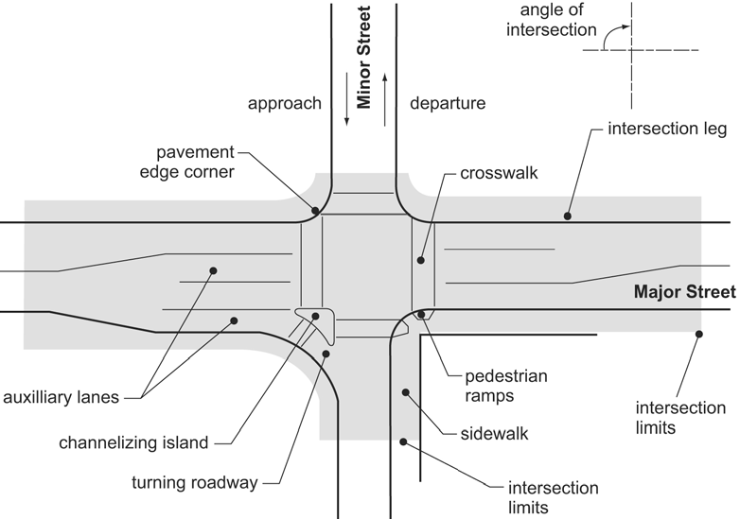
Intersection: Definition & Key Elements

Slide 4
Key Elements (1)
The major street is typically the intersecting street with greater traffic volume, larger cross-section, and higher functional class. The minor street is the intersecting street likely to have less traffic volume, smaller cross-section and lower functional classification than the major street.
Intersection legs are those segments of roadway adjacent to the intersection. The leg used by traffic approaching the intersection is the approach leg, and that used by traffic leaving is the departure leg.
Sidewalks, crosswalks and pedestrian curb cut ramps are considered to be within the intersection. The pavement corner is the curve connecting the edges of pavement of the intersecting streets.
The angle of intersection is formed by the intersecting streets’ centrelines. If the angle departs significantly from right angles, the intersection is called skewed intersection
Auxiliary lanes are lanes added at the intersection, usually to accommodate turning motor vehicles. They may also be used to add through lanes through an intersection.

Slide 5
Key Elements (2)
Channelizing and divisional islands may be added to an intersection to help delineate the area in which vehicles can operate, and to separate conflicting movements. Islands can also provide for pedestrian refuge.
A turning roadway is a short segment of roadway for a right turn, delineated by channelizing islands. Turning roadways are used where right-turn volumes are very high, or where skewed intersections would otherwise create a very large pavement area.
Traffic control devices assign right of way, to both motorized and non-motorized traffic and include traffic signals, pavement markings, STOP signs, YIELD signs, pedestrian signal heads and other devices

Slide 6
Junction Users
Pedestrians
Bicycles
Motor vehicles
Transit (Public Transport)
Owners and users of adjacent land often have a direct interest in intersection design, particularly where the intersection is surrounded by retail, commercial, historic or institutional land uses. Primary concerns include maintenance of vehicular access to private property, turning restrictions, consumption of private property for right-of-way, and provision of safe, convenient pedestrian access.

Slide 7
Pedestrian
Characteristics of Junction Users
Key elements affecting intersection performance for pedestrians are:
(1) Amount of right-of-way provided for the pedestrian including both sidewalk and crosswalk width, accuracy of slopes and cross slopes on curb cut ramps and walkways, audible and/or tactile cues for people with limited sight, and absence of obstacles in accessible path
(2) Crossing distance and resulting duration of exposure to conflicts with motor vehicle and bicycle traffic
(3) Volume of conflicting traffic
(4) Speed and visibility of approaching traffic

Slide 8
Motor Vehicles
Characteristics of Junction Users
Key elements affecting intersection performance for motor vehicles are:
Type of traffic control
Vehicular capacity of the intersection, determined primarily from the number of lanes and traffic control
Ability to make turning movements
Visibility of approaching and crossing pedestrians and bicycles
Speed and visibility of approaching and crossing motor vehicles

Slide 9
Bicycles
Characteristics of Junction Users
Key elements affecting intersection performance for bicycles are:
(1) The degree to which pavement is shared or used exclusively by bicycles
(2) The relationship between turning and through movements for motor vehicles and bicycles
(3) Traffic control for bicycles
(4) The differential in speed between motor vehicle and bicycle traffic

Slide 10
Transit
Characteristics of Junction Users
Key elements of intersection performance for transit are:
(1) When transit operations involve buses, they share the same key characteristics as vehicles.
(2) A transit stop in an intersection area, influence pedestrian, bicycle, and motor vehicle flow and safety
(3) When appropriate the unique characteristics of light-rail transit must be taken into account

Slide 11
User Characteristics: Pedestrian
Pedestrian requirements must be fully considered in the design of intersections.
Crossings and Pedestrian Curb Cut Ramp Locations - Locations should correspond to the placement of sidewalks along approaching streets, and likely crossing locations. Pedestrian curb cut ramps need to ensure accessibility to crossing locations.
Walking Speed – Under normal conditions, pedestrian walking speeds on sidewalks and crosswalks range from 2.5 feet per second to 6 feet per second. Elderly pedestrians and young children will generally be in the slower portion of this range. A walking speed of 3.5 to 4 feet per second for crosswalk signal timing is widely accepted as a guideline for walking speed in crosswalks.
Pedestrian Flow Capacity – The number of pedestrians per hour that can be accommodated by the facility under normal conditions.
Traffic Control, Yielding and Delay - In addition to pedestrian flow capacity, pedestrians are significantly affected by the type of traffic control installed at an intersection, the specific parameters of the control, and the resulting motor vehicle operations. At signalized intersections, the length and frequency of time provided for pedestrian crossings, the clarity of information provided, conflicting turning movements, and motor vehicle yielding are key influences on pedestrians’ ability to cross the street, and on delay.

Slide 12
User Characteristics: Motor Vehicles
The following important characteristics of motor vehicles are considered in intersection design:
Design Vehicle - The largest type of motor vehicle that is normally expected to be accommodated through the intersection.
Design Speed - The motor vehicle speed selected on adjoining segments of roadway. Motor Vehicle Capacity - The number of motor vehicles that can be moved through an intersection under normal conditions.
Traffic Control - Much like other users, motor vehicles are influenced by the type and timing of traffic control installed at an intersection, and number of other users. At roundabouts, STOP controlled, YIELD controlled, and uncontrolled intersections, motor vehicle capacity and delay are influenced by conflicting traffic streams. At signalized intersections, the time provided for each movement, conflicting turning movements, and the volume and mix of other users are key influences on both motor vehicle capacity and delay.

Slide 13
User Characteristics: Bicycles
Bicyclists’ needs must be integrated into the design of intersections. When travelling with motor vehicles, bicyclists are subject to motor vehicle traffic laws.
Cross-section - Bicyclists position themselves for their intended destination regardless of the presence of bike lanes or shoulders. If bicycle lanes are present, the design needs to insure that bicyclists can merge to the proper location based on the bicyclist’s intended destination.
Operating Speed - At unsignalized intersections, an average bicycle speed of 15 miles per hour can be assumed on the major street. On the minor street, bicyclists usually stop or slow, and travel through the intersection at speeds well below 15 miles per hour. At signalized intersections, bicyclists receiving the green signal proceed through the intersection at an average speed of 15 miles per hour. Bicyclists who have stopped for a signal proceed through the intersection at speeds well below 15 miles per hour.
Bicycle Capacity - The number of bicycles per hour that can be accommodated by the facility under normal conditions.
Traffic Control - Bicyclists are required by law to obey control devices at intersections. Therefore, traffic control devices need to account for bicycle activity.

Slide 14
User Characteristics: Transit
Transit vehicles are largely treated as motor vehicles at an intersection.
The transit specific characteristics are as follows:
The turning path of the design vehicle appropriate for most types of transit service is has to be accommodated. Tracked transit vehicles, such as trolleys, have turning radii as specified by their manufacturer. Their interactions with other traffic elements must be taken into account where applicable.
Transit stops are often located at intersections either as a near-side stop on the approach to the intersection or as a far-side stop on the departure leg of the intersection. Location near intersections is particularly advantageous where transit routes cross, minimizing the walking distance needed for passengers transferring between buses.
The total amount of time a transit vehicle will block traffic movements can then be estimated using the number of passenger boarding and alighting at a stop.

Slide 15
Principles of intersection design
Principles of Design
Safety and efficiency are the two main factors to be considered.
The use of same road space for different manoeuvres or same manoeuvres at different speed or different path causes conflicts. The aim of a successful design is to optimally mitigate the number of conflicts.
Conflict points:

Slide 16
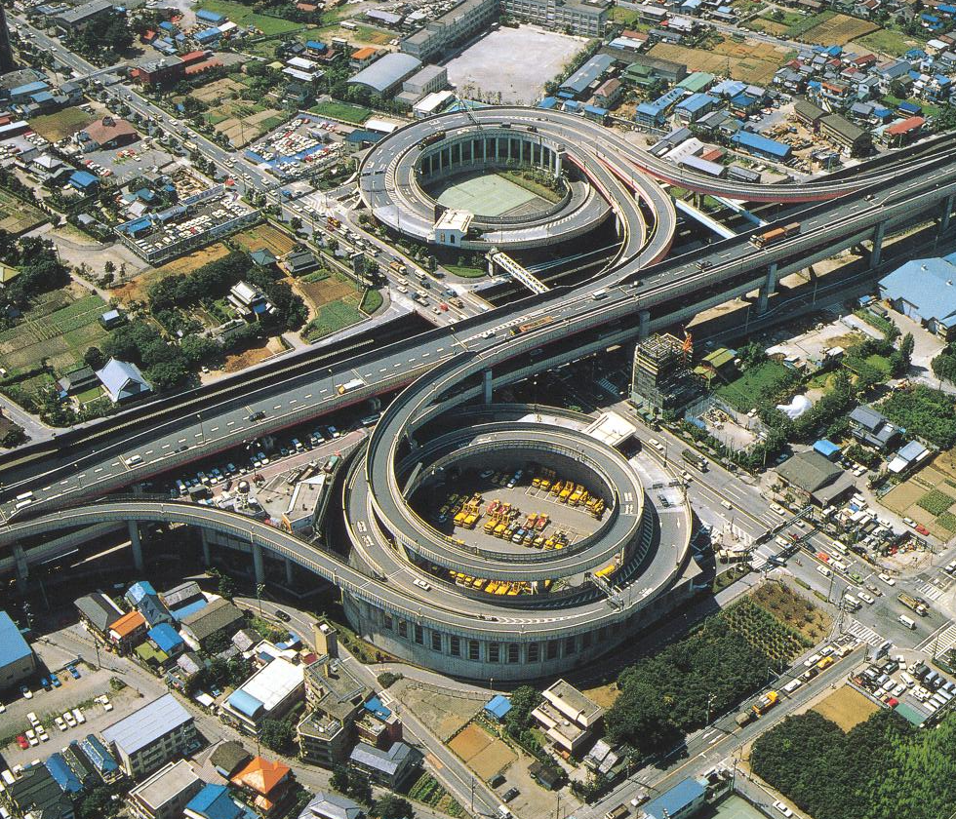
Intersection types
At-grade
Grade separated
With ramps (Interchanges)
Without ramps (meaning no connection between the intersection roads!)

Slide 17
Intersection Types
Basic intersections are three-leg (or T), four leg, and multi-leg intersections.

Slide 18
Junction Types
Intersections can be categorized into four major types:
Simple Intersections
Simple intersections maintain the street’s typical cross-section and number of lanes throughout the intersection, on both the major and minor streets. Simple intersections are best-suited to locations where auxiliary (turning) lanes are not needed to achieve the desired level-of-service, or are infeasible due to nearby constraints. Generally, simple intersections provide the minimum crossing distances for pedestrians and are common in low-volume locations.
Flared Intersections
Flared intersections expand the cross-section of the street (main, cross or both). The flaring is often done to accommodate a right-turn lane, so that turning vehicles are removed from the through-traffic stream to increase capacity at high-volume locations, and safety on higher speed streets. Adding flare to an intersection increases the pedestrian crossing distance and time.

Slide 19
Junction Types
Channelized Intersections
Channelized intersections use pavement markings or raised islands to designate the intended vehicle paths. The most frequent use is for left-turns, particularly when accompanied by an auxiliary left-turn lane. At skewed intersections, channelization islands are often used to delineate left turns. At large intersections, short median islands can be used effectively for pedestrian refuge. The design of channelized intersections needs to ensure that the needs of pedestrians are considered.
Roundabouts
The roundabout is a channelized intersection with one-way traffic flow circulating around a central island. All traffic—through as well as turning—enters this one-way flow. Although usually circular in shape, the central island of a roundabout can be oval or irregularly shaped.

Slide 20
Intersection Types

Slide 21
At-grade intersection design objectives and considerations
Need to meet two conflicting objectives:
Minimize the severity of potential conflicts among different streams of traffic and between pedestrians and turning vehicles.
Provide for the smooth flow of traffic across the intersection
Operating characteristics of both the vehicles and pedestrians
Adequate pavement width and approach sight distances must be provided.

Slide 22
At-grade intersection design considerations
Alignment and profile design
Angle of intersecting roads
Suitable channelization system for the traffic pattern
Minimum required widths of turning roadways
Adequate sight distance for the type of traffic control used (no control, Yield, Stop, Signal)

Slide 23
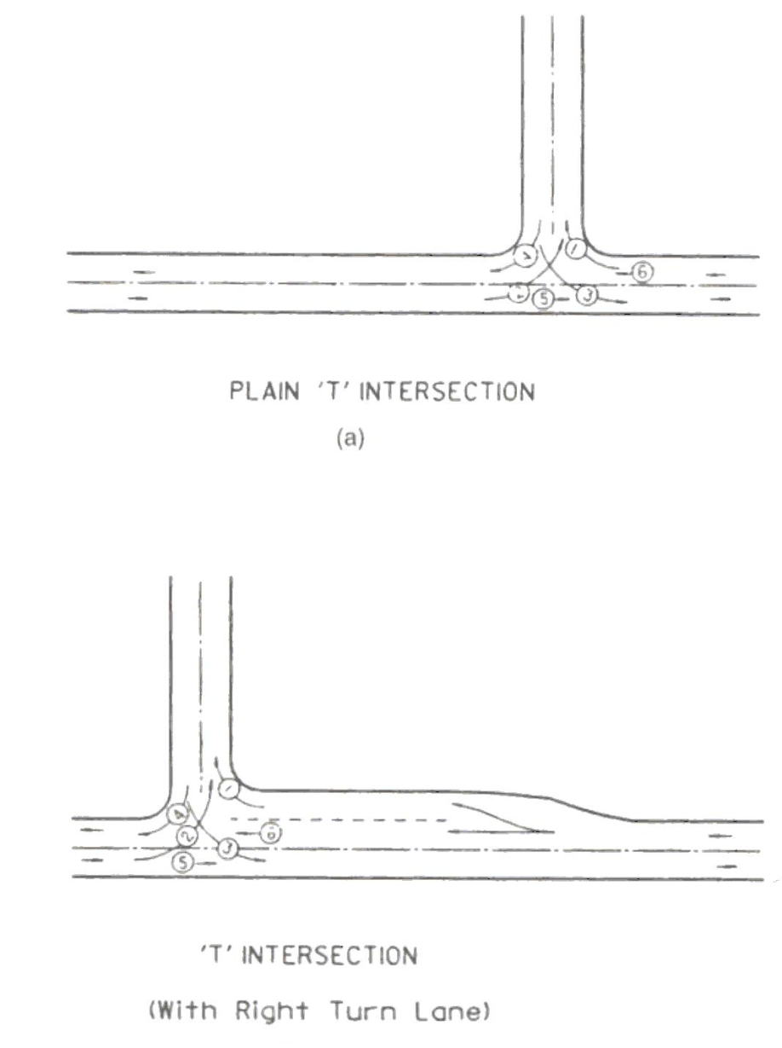
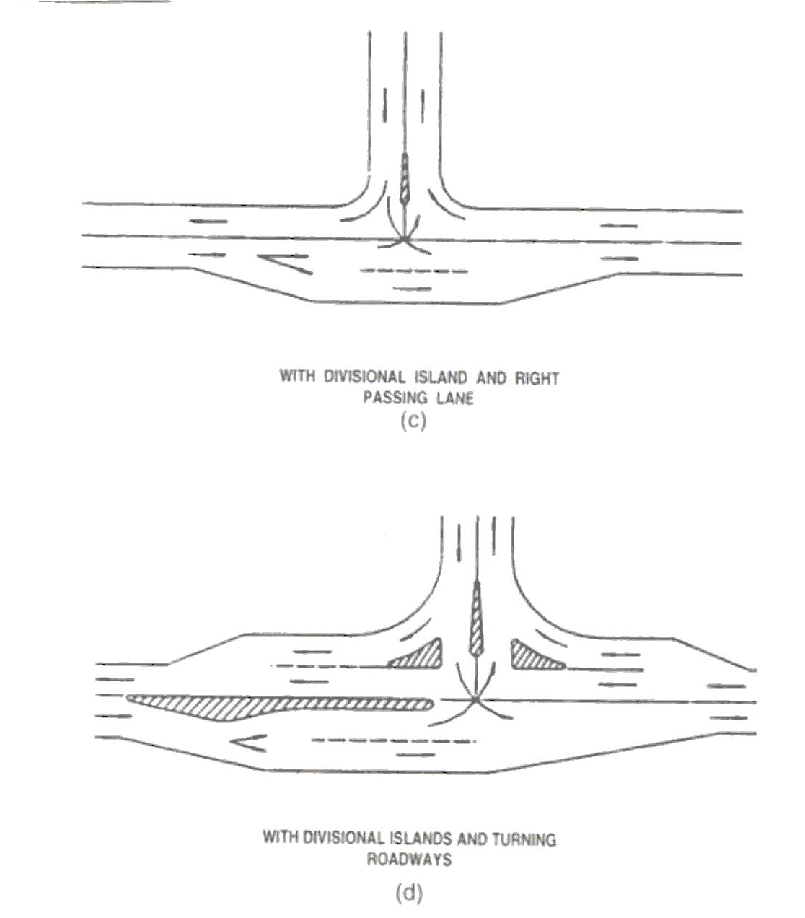
At-grade intersections (pay attention to channelization techniques): T or 3-leg

Slide 24
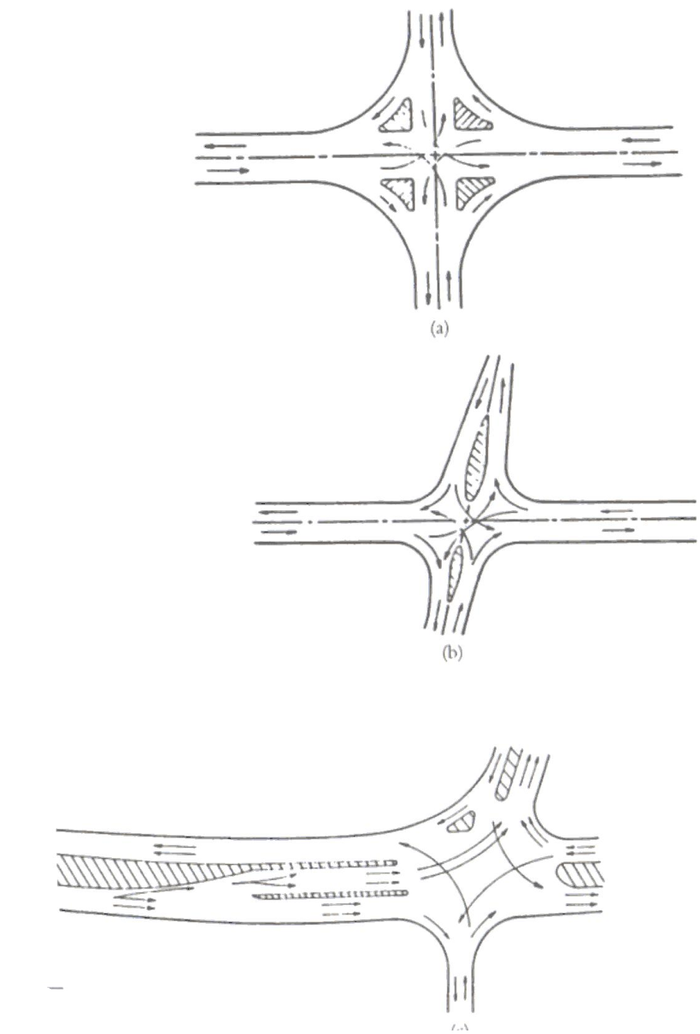
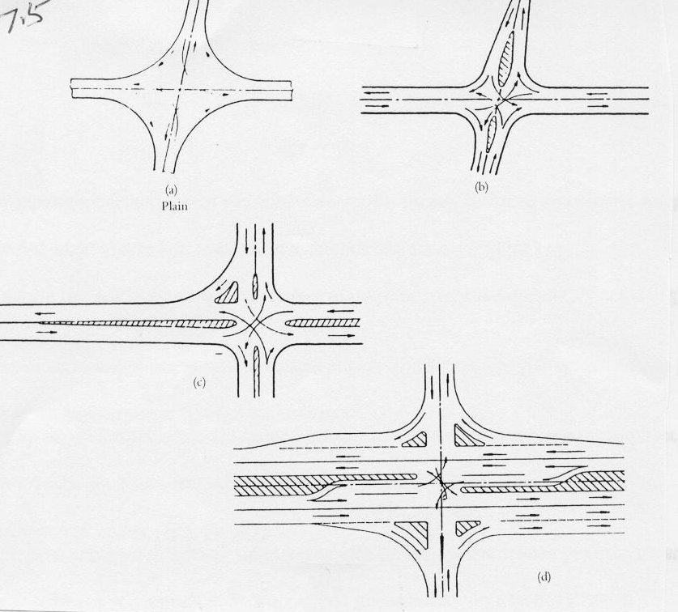
At-grade intersections (pay attention to channelization techniques): 4-leg

Slide 25
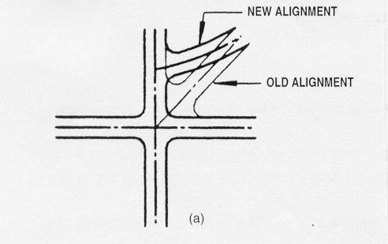
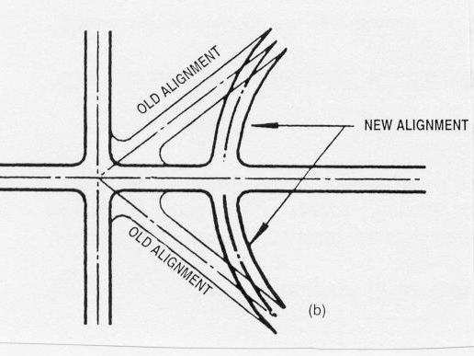
At-grade intersections (pay attention to channelization techniques): Multi-leg
Mulry Square in Greenwich Village, Manhattan, New York City

Slide 26
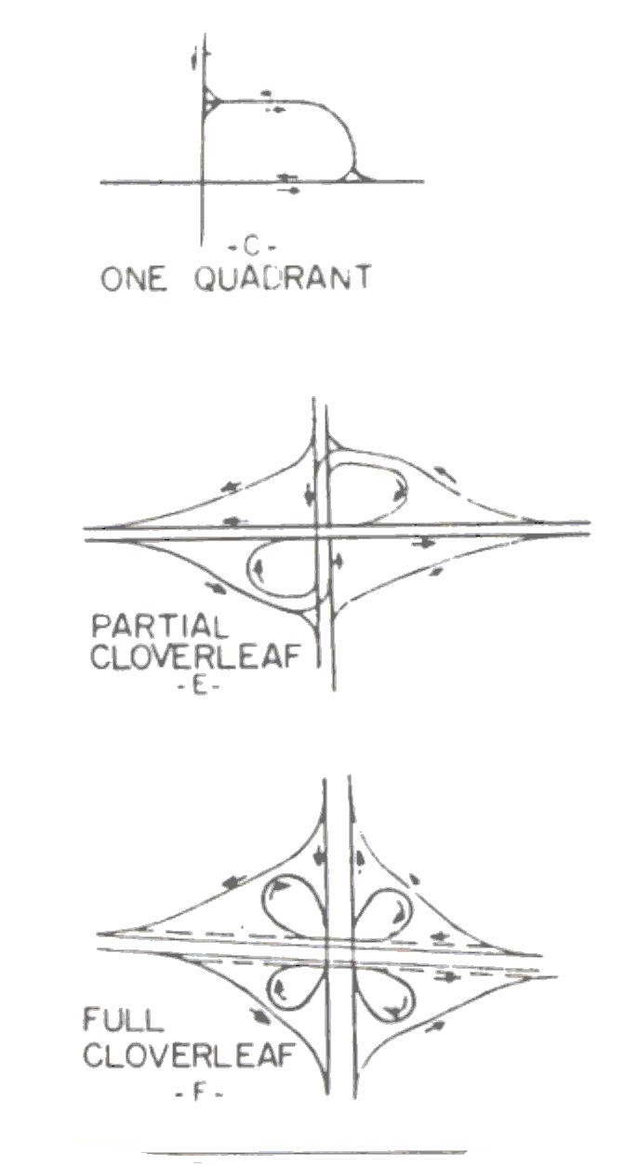
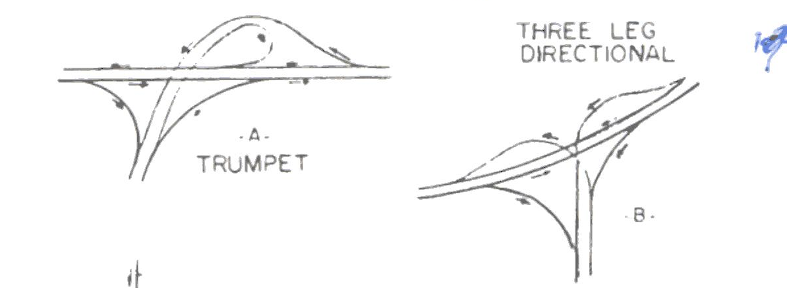
Examples of grade separated interchanges

